Slide 1
Quarter 3
Jackson Paull, 8

Slide 2
What I did this quarter

Slide 3
I focused on
Melee Attacks
Combo Attacks
Ranged Attacks
Sprite changing
Enemy health and death
Mask/ hitbox changing
Lighting

Slide 4
TEAKS

Slide 5
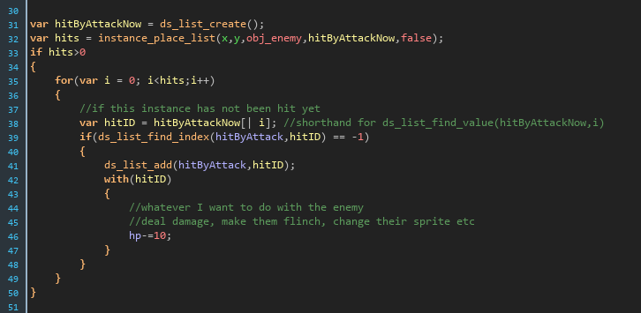
TEAK 1 - Looping
Throughout my code I have used looping so that I can traverse data structures and access data that I need.
In the example provided I use a for loop to traverse through all enemies hit by an attack and add them to a list that prevents them from being hit by the same move in the next frame, before dealing damage to them.

Slide 6
TEAK 2 - Data Structures
I have used data structures such as instance variables, lists, priority queues, global variables, static variables, and many more to accomplish several discrete complex tasks.
In the same code as the previous slide, I use a list to both store what has been hit by an attack as well as what has been hit by an attack in a given frame. I compare the two lists to see if the list compiling everything hit by the attack contains everything hit this frame, and if not everything hit this frame is put into that list and dealt damage

Slide 7
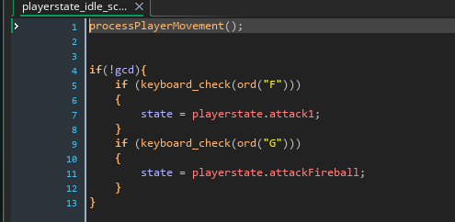
TEAK 3 - Input and Output
I use input and output throughout my code so that my game can be interactive, otherwise it would be an animation.
The small code segment to the right is a very efficient and clean way to process input and provide output. The code only runs when the player is in an “idle” state, and first allows movement. It then checks to make sure the player can actually GIVE input, then sets the state to the appropriate state which, in the next frame, has its own unique code to execute. This simultaneously removes the player from the idle state, causing no recursive issues.

Slide 8
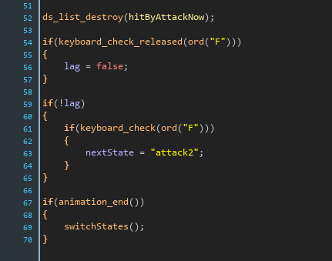
TEAK 4- If Else If
My game uses several if and else statements to assess and process the state that the game is in.
In the example shown to the right, I use three if statements in a specific order to first check if the player has released a key before pressing it again. I then check to see if the animation is ending, as I would not want to switch out of a state before completing it’s code.

Slide 9
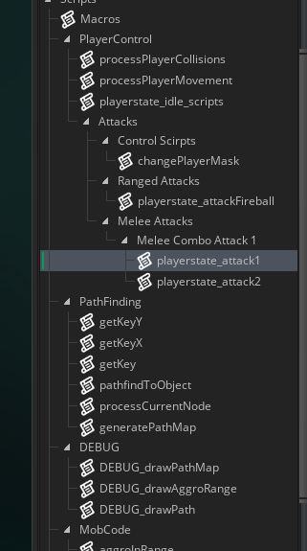
TEAK 5- Methods
My code is full of unique scripts, which are the equivalent of methods in GML.
All of the scripts shown to the right serve a specific purpose. These scripts also improve efficiency and readability. For instance, the DEBUG_drawPathMap() method would be a set of very complex data structures, draw commands, loops and otherwise, but a call to the method instead allows a reader to very quickly understand what is happening.

Slide 10
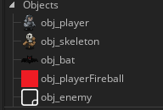
TEAK 6- Classes
Objects are the closest thing to classes in GML
Each of the objects to the right is placed or created somewhere in the game, with the exception of the enemy object, which serves as a parent to all enemies in the game, so I can check for collisions with a single parent as opposed to looping through every enemy. Each object has its own instance variables, ways to access them, and everything else that a typical class has in Java.

